Slide 1
The Ecumenical Imperative
The Corrymeela Community as an example of applied ecumenism
Notes:
Jesus prayed: “May they be one, that the world may believe”. The Ecumenical Imperative lay behind the birth of Corrymeela. Once people got the point then everything else followed. The contradictions had become obvious, first to those outside, and more slowly to those within the Churches. We will see the effect of this prayer on a small group of people.

Slide 2
A view from Corrymeela
Notes:
This picture was taken outside the Corrymeela Centre in Ballycastle, Co. Antrim. Looking north to Rathlin Island.

Slide 3
Corrymeela, the beginnings
Founded in 1965 in response to a divided Church, a divided people and a divided world.
It developed around Ray Davey, a Presbyterian student chaplain, who had been a prisoner in World War II.
Notes:
His great challenge to all and sundry after the war was to win the peace. This task is even greater and deeper.
It would take the same resilience and guts as he had seen in the soldiers.

Slide 4
Ray asked: “what do I do now?”
Ray’s return to Ireland after the war, presented him with a challenge.
The answer came when the decision was made to appoint him as student chaplain to Queen’s University, Belfast.
Notes:
He was the first full time Presbyterian student chaplain in Ireland. There were no guidelines. He had to discover how to be a chaplain to students. So this was just the challenge that he needed at that time. The troops were one thing, university students were quite a different matter.

Slide 5
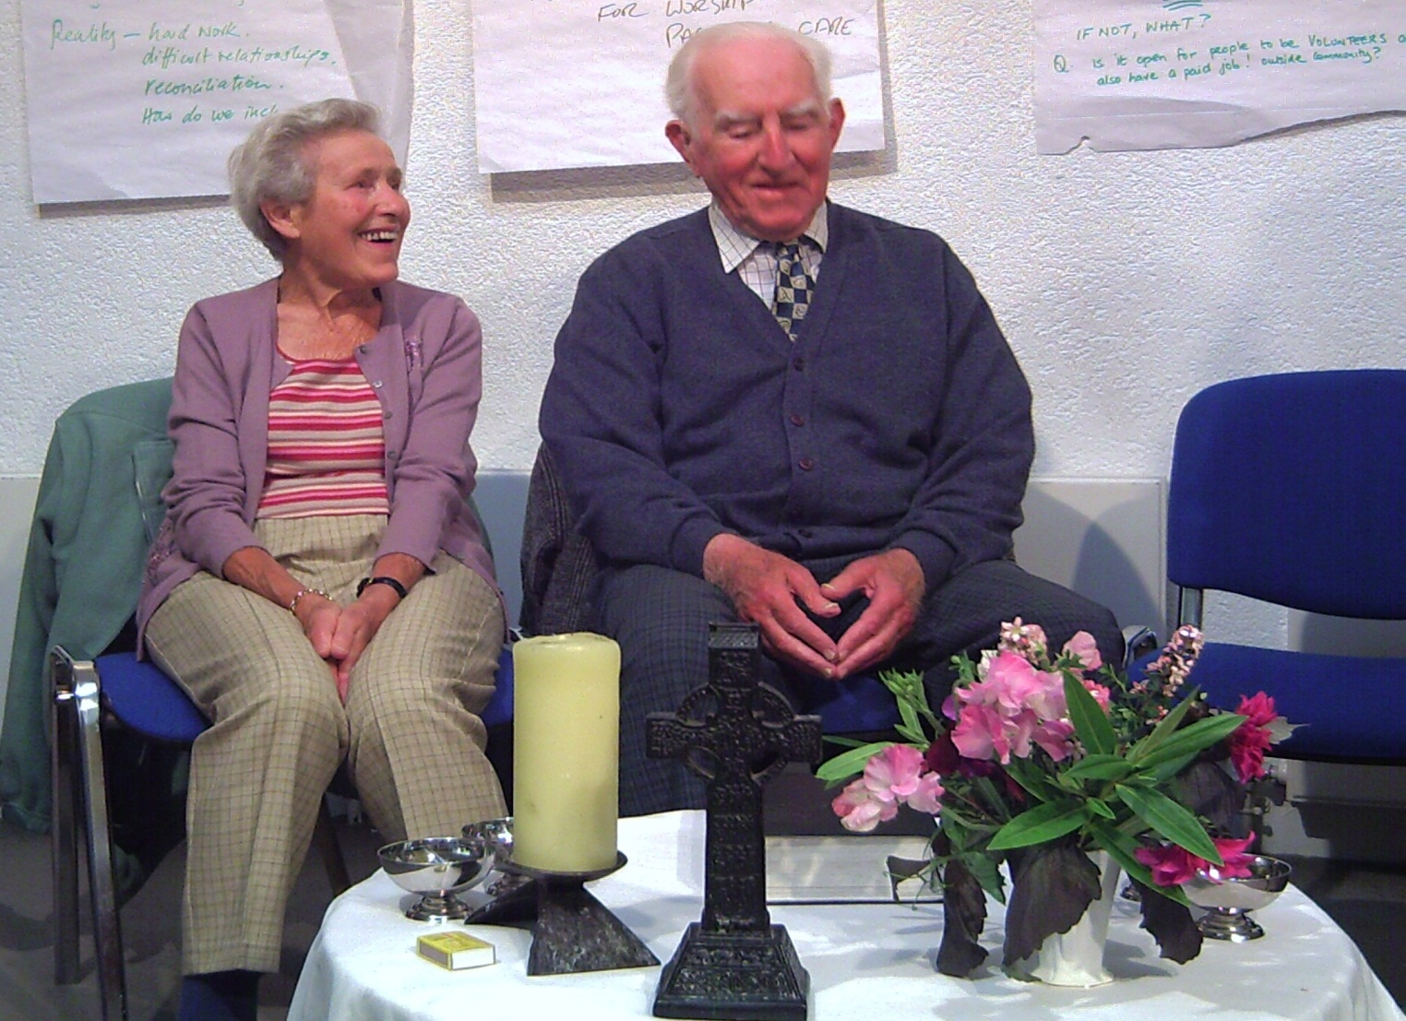
Ray & Kathleen Davey 2005
Notes:
After the war, the first thing Ray Davey did was to marry his beloved Kathleen. This is Ray and Kathleen 40 years after the birth of the Community at the launch of his war diaries. You can see a Celtic cross made of turf. It is a copy of a famous High Cross at Monasterboice in Ireland.

Slide 6
The gift of community
Ray stressed the importance of community as a valuable contribution of the Church to society.
In his first book “Don’t fence me in” Ray wrote “Christian Community, in spite of all its lamentable divisions and failure, is the only hope for the world.”
Notes:
The experience of a special form of community among the soldiers in North Africa and also among fellow prisoners of war, had a big effect on him.

Slide 7
“Don’t fence me in”
“The Christian Community transcends colour and class, its terms of reference and its motive power are from beyond, outside man himself.”
In this (1954) book he spelled out the crucial importance of Community. In his work with students he responded to their quest for a viable and worthwhile Christianity.
Notes:
The evocative title of his first book speaks about being a prisoner of war, and a sense of being imprisoned in an inward looking church community.

Slide 8
Notes:
The Davey Village (the DV) has been in use since 2011 and named in memory of our founding leader, the Revd. Dr. Ray Davey and his wife Kathleen, the official opening was in 2012. The Corrymeela Logo and badge is a stylised version of a Celtic cross with a suggestion of the cross linking the four corners of the world.

Slide 9
Other communities
Iona, in Scotland
Agape, in Italy
Taize, in France
These provided inspirational experiences and prepared the way for an Irish response.
Notes:
These other three communities are stories in themselves. They express a prophetic message in their own contexts.

Slide 10
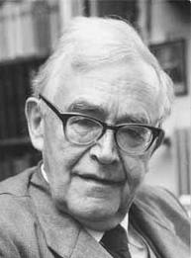
Karl Barth in Basel
“The greatest theologian since Aquinas” said Pope Pius XII
Notes:
On one of the student vacation trips, organised by Ray Davey in the 1950s, they passed through Basel, in Switzerland. As it happened, the great Karl Barth agreed to meet them.

Slide 11
A student’s question
One very eager student asked the great theologian, what was the most important thing that they could do for the peace of the world?
Karl Barth replied: “Set your own house in order”.
Ray Davey comments : “Working for peace is not usually dramatic or spectacular and it begins with each one of us – where we are.”
Notes:
Students often think that they can change the world in one great gesture. Ray was able to give them experiences that then harnessed their vitality.

Slide 12
The work starts..
And so, in 1965 the Corrymeela Community came into existence.
It centred on a former Christian holiday facility on a cliff top outside Ballycastle, Co. Antrim.
From this site you can see Scotland quite clearly when the weather permits.

Slide 13
Scotland beyond Fair Head
Notes:
Weather sometimes permits us to look at the Mull of Kintyre. The island of Iona is north of the Mull of Kintyre.

Slide 14
Early aims
The initial emphasis was on the promotion of ecumenism and addressing the tense political situation. This was before the “Troubles” began in 1969.
The tension turned to violence involving both Nationalists and Loyalists. (“Nationalist” and “Loyalist” roughly coincide with Roman Catholic and Protestant.)
Notes:
The first major political conference hosted by Corrymeela was held in 1966. The Prime Minister of Northern Ireland, Terence O’Neill was the main speaker.

Slide 15
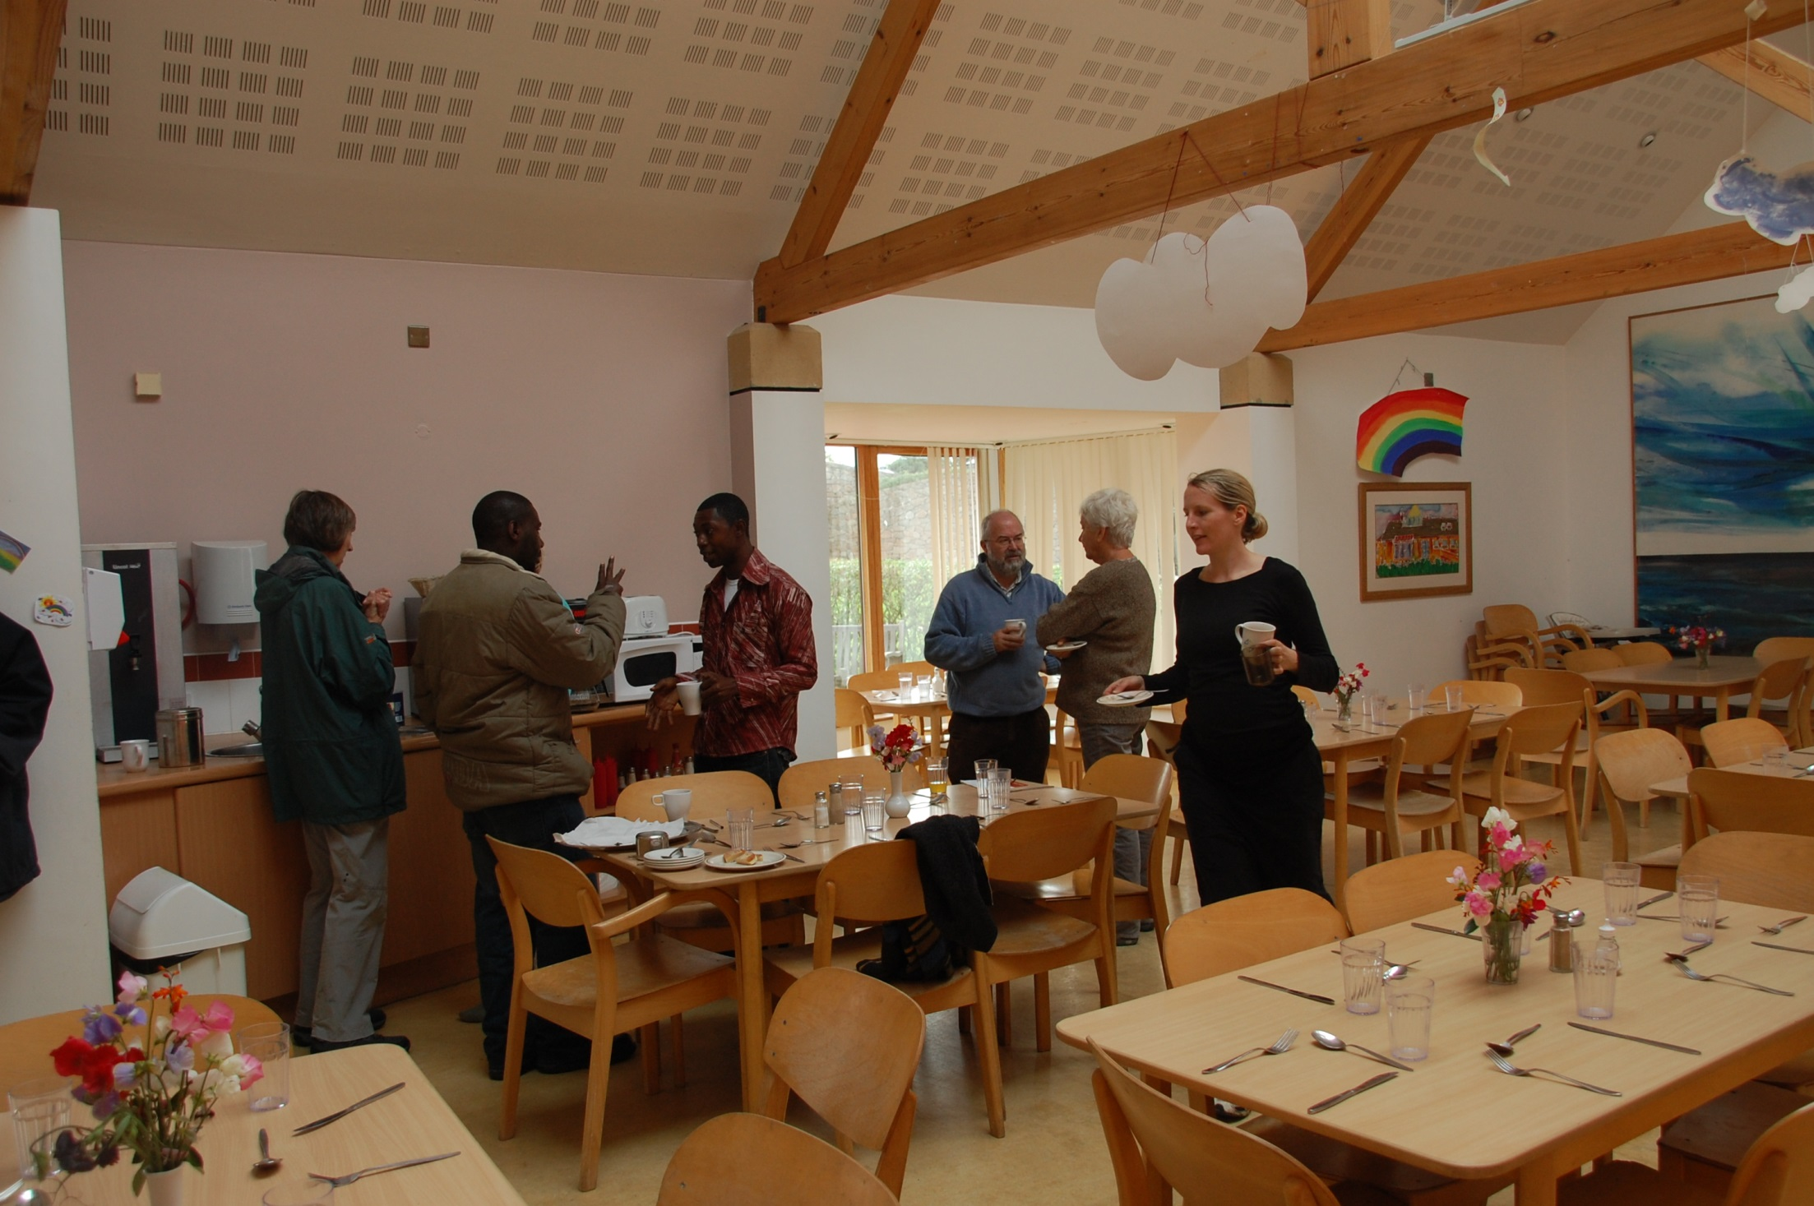
Notes:
People come together from many backgrounds and traditions – the dining area is a great meeting place.

Slide 16
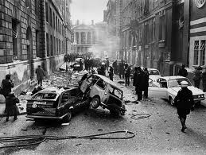
Belfast in turmoil
Chaos on
the
streets
Notes:
This is the context in which Corrymeela developed from 1969 onwards.

Slide 17
Conflict develops
It became obvious that something had to be done for children and families from the most dangerous localities.
Corrymeela joined with all the schools in Ballycastle to give emergency shelter.
The need for reconciliation work became foremost for the Corrymeela Community.
Notes:
One of the early members of Corrymeela was a social worker in Belfast who alerted Ray Davey to the plight of families. He contacted all the schools in Ballycastle who joined in a scheme to give safe shelter to at least some of the families. Other places did the same.

Slide 18
Cutting edge of ecumenism
This is the cutting edge of the ecumenical movement:
The recovery of a sense that the Christian Church is called to display in her life an example of a unifying and reconciling community.
Notes:
Rampant individualism does not concern itself with unity and also closely resembles the consumer society that was developing throughout the 20th century. Such an unrelieved emphasis on individual salvation often distracts from concern for the body politic and also from the work of reconciliation.

Slide 19
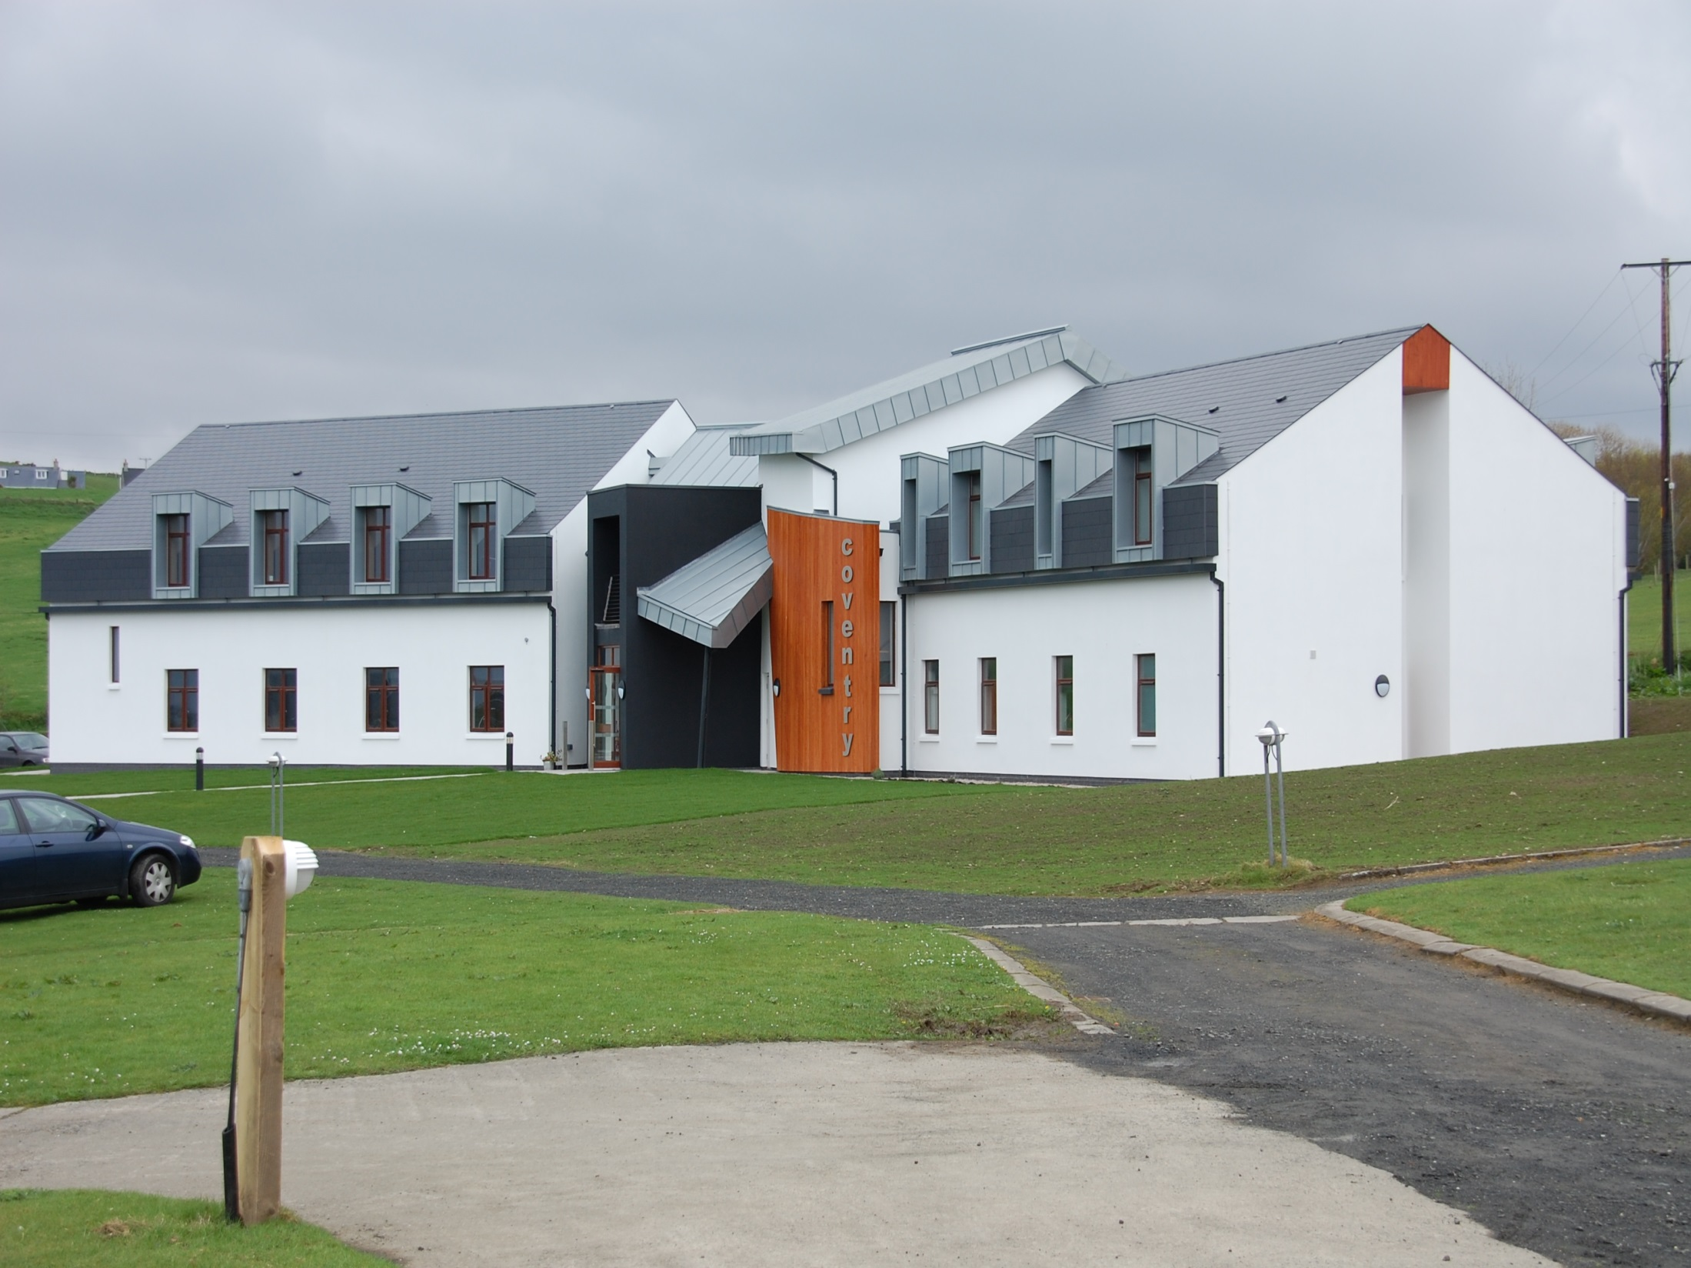
Notes:
This is Coventry House where the year long volunteers live in community. The original Coventry house was funded by Coventry Cathedral in England, which had been fire bombed in the 2nd world war, but became a symbol of reconciliation by reaching out to the people of Dresden who had suffered also.

Slide 20
The name “Corrymeela”
For many years we were quite satisfied with a romantic interpretation of the name. In Irish it could be broken into two words: Corry-meela.
The first part could be a rock or a hill and the second a word for honey or sweetness.
So we used to say it was the “Hill of Harmony”.
Notes:
Everything is not all sweetness and light in reconciliation work or in a reconciliation community.

Slide 21
Realistic meaning of Corrymeela
The ancient name of the parish means ‘the corner of the stranger’.
The most likely old form of Corrymeela was Corrymellagh, which means ‘the lumpy crossing place’.
This older meaning provides a much more realistic sense of what Corrymeela has always been about.
Notes:
Corrymeela is in the parish of Culfeightrin, meaning “the corner of the stranger”. According to an Irish scholar the most likely old form of Corrymeela was Corrymellagh, which means “the lumpy crossing place”. A more realistic interpretation for a reconciliation community.

Slide 22
Together in rough ground
Notes:
A group of members and friends on top of Fair Head, Co. Antrim. Quite a “lumpy crossing place”.

Slide 23
No longer strangers
People come to our centre as strangers and hopefully end up at least knowing each other, and maybe even as friends.
But with some stumbles on the way, reflecting ‘the lumpy crossing place’.
The genius of Corrymeela’s interaction with people is based on accepting people as they are.
Notes:
Only through this radical acceptance can the truth about ourselves and others begin to set people free.

Slide 24
Entrance to the Centre
Notes:
This is the Main House Entrance. It was built in 1998 to replace the old wooden building.

Slide 25
How is it done?
What happens at Corrymeela does not depend only on words and involved political and theological discussions.
Moralistic attitudes are out of place.
People are invited to play games about flags or culture, and also to describe what life is like for them in their home community life & listen to others.
Notes:
The play approach can be adapted to all ages and backgrounds. It also helps people to meet on the same level and hear each other.
Moralistic attitudes lead to people being put in categories of ‘bad’ and ‘good’.

Slide 26
All ages can play games

Slide 27
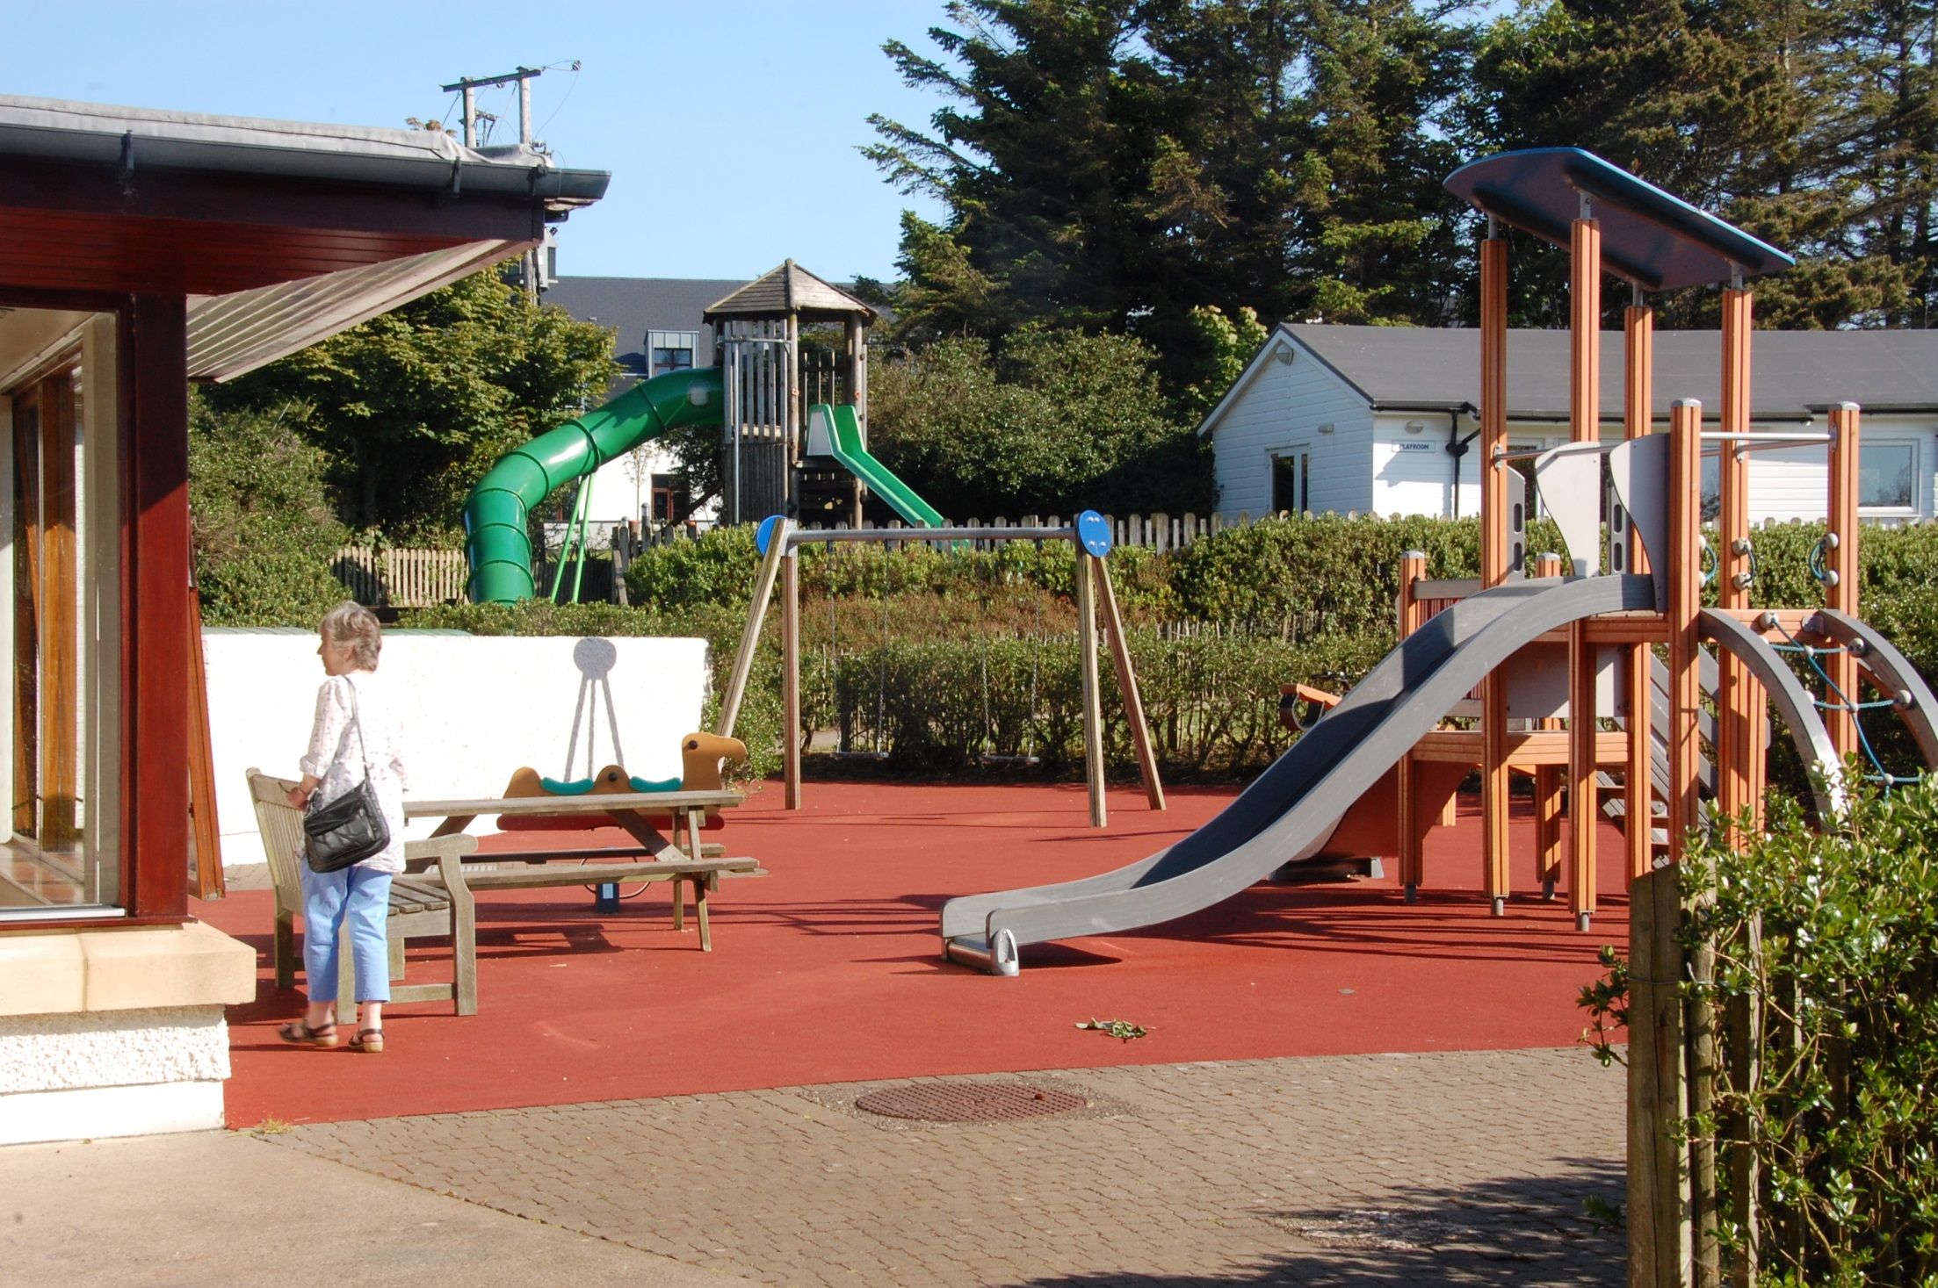

Slide 28
Humanity and Hope
The hope is that each one will discover the humanity of the other.
This is the hoped for outcome. Nothing is guaranteed.
Things can go seriously wrong.
Notes:
When things go wrong a lot depends on how difficulties are addressed. Hopefully again, there will be someone present who can come alongside and talk about the human situation in a way that releases the tension. If this does not work, that is that, and reconciliation is postponed or maybe never happens.

Slide 29
Ireland has changed
The simple divisions between Catholic and Protestant, Nationalist and Loyalist, are no longer adequate.
People, from other continents have become the new scapegoats.
And so, ecumenism has to face new challenges.
Notes:
Since the Good Friday Agreement of 1998 it is no longer acceptable to knock the traditional enemies, Catholic or Protestant. In their place many immigrants have suffered rejection and to a certain extent persecution because they are different. Ireland is now multi-ethnic and multi-faith.

Slide 30
Challenges of change
The greater openness of people about their sexual orientation is also a new challenge.
Society generally seems to accept this development.
The Churches, on the other hand, are divided within themselves on this issue.
Notes:
There is now provision for same sex Civil Partnership in both Northern Ireland and the Republic of Ireland. Many in the Churches have great difficulty with this development.

Slide 31
“Lord, make me an instrument of your peace”
Notes:
Amongst the buildings at the Centre is the Croi, where people meet for different activities including worship which happens twice a day. On the door is part of the Franciscan prayer.

Slide 32
Entrance to the Croi
Notes:
The Croi is set into the landscape there is a garden over the entrance. Prayer is an aspect of life at the Centre.

Slide 33
What do members experience?
Walking, talking, playing, singing, sharing.
Also, acceptance, working, eating, worshipping & praying together.
.

Slide 34
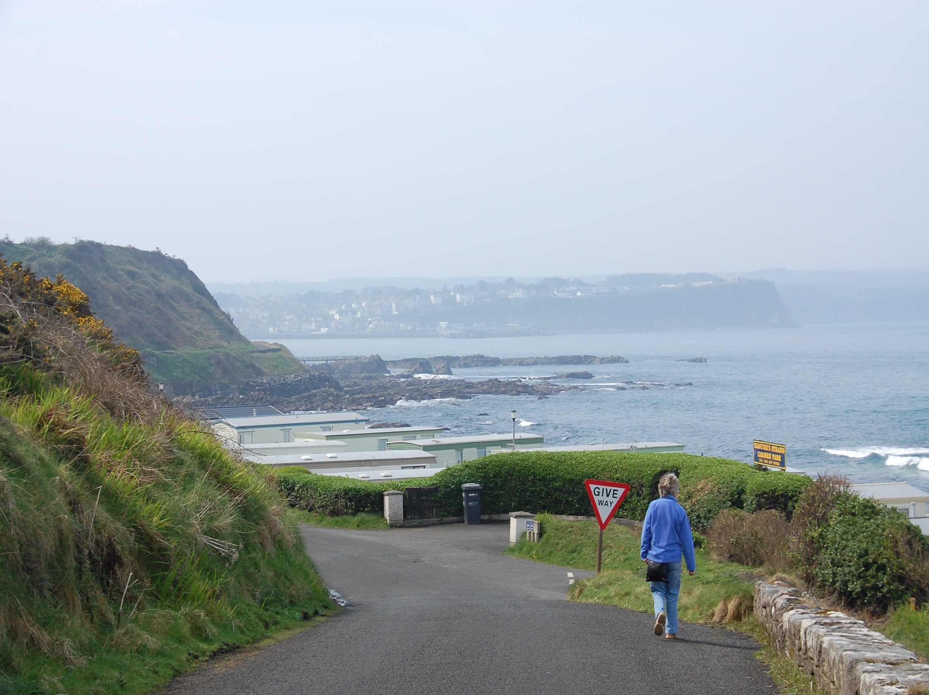
Notes:
This picture is taken on the road leading down from the Corrymeela Centre. The sign “Give Way” is very apt because it can be seen from both roads -the Lower road coming up from the right and the one we see. It suggests that reconciliation and ecumenism involves each giving way.

Slide 35
The Ecumenical Imperative
The roots of the Corrymeela Community were forming when the ecumenical movement was spreading.
The World Council of Churches had been formed in 1948. Next came Pope John 23rd and the Second Vatican Council.
Notes:
All of this applies to the ecumenical challenge to the Christian Churches or as I put it the Ecumenical Imperative. The German National Church, which played along with Hitler, was opposed by people like Karl Barth, Martin Niemoller & Dietrich Bonhoeffer who had a serious moral message for the whole world.

Slide 36
Ray Davey’s vision still inspires
For the Corrymeela Community this means attempting three things:
Embracing difference
Healing divisions
Enabling reconciliation
Notes:
Ray Davey’s words and example still inspire. They are still a call to bring light into the darkness, still a daunting challenge.

Slide 37
A question for the Church!
These tasks are for the whole Church of Christ in the world.
The work of ecumenism is surely to
Embrace difference
Heal divisions
Enable reconciliation
Notes:
Ray Davey and his community of students, and their supporters, had a sense that they needed to be somewhat independent of Church control to obey the Ecumenical Imperative. Then later, they discovered an even more urgent role – enabling reconciliation.

Slide 38
Inderjit Bhogal
Notes:
Finally, the present Leader of the Corrymeela Community, Inderjit Bhogal. Is he asking: Where to now?

Slide 39
Light in the darkness
Notes:
Ray Davey died in April 2012, aged 97. He was an inspiration to many people. It is our task is to respond to the present challenges and provide light in the world. As Ray said so often: “It is better to light a candle than to curse the darkness”.

